Slide 1
PCA in Variability Analysis
Saritha Thampan

Slide 2
Analysis Objective
A dataset containing Spectrometer Readings at 100-1095 nm wavelength scale for 10 Specimens of a Chemical Compound measured in R & D Lab and 10 Specimens of the same compound in Manufacturing environment.
Conduct a PCA to see if it’s possible to reduce the ZZ variable dataset to only 1-4 Principal Components that can more easily compare the variability between the R&D and manufacturing environment
develop a single quantitative value measuring the variability in each of these two environments.

Slide 3
Variables and Data Examined
Spectrometer readings for specimens for 200 different wavelengths (100nm-1095 nm) (10 in R&D lab, 10 in Manufacturing Line)

Slide 4
Executive Summary
Principal Component Analysis was performed on 20 observations on 200 variables and 4 principal components were identified
So the data was reduced to 20 observations on 4 principal components
The first principal component was determined to be single quantitative value accounting for 11.4% of the variability in data in the original 200 variables
The scatterplot of PC1 vs PC2 shows greater variability for PC1 than PC2 between R&D and manufacturing lines

Slide 7
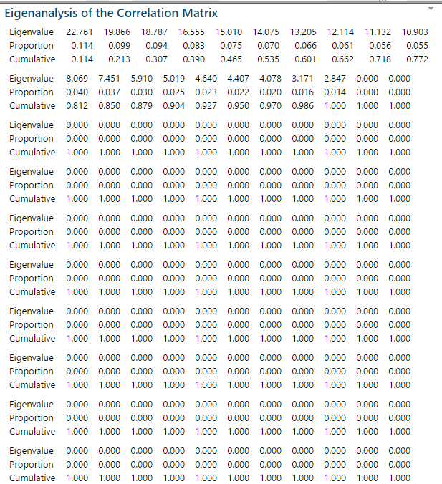

Slide 9
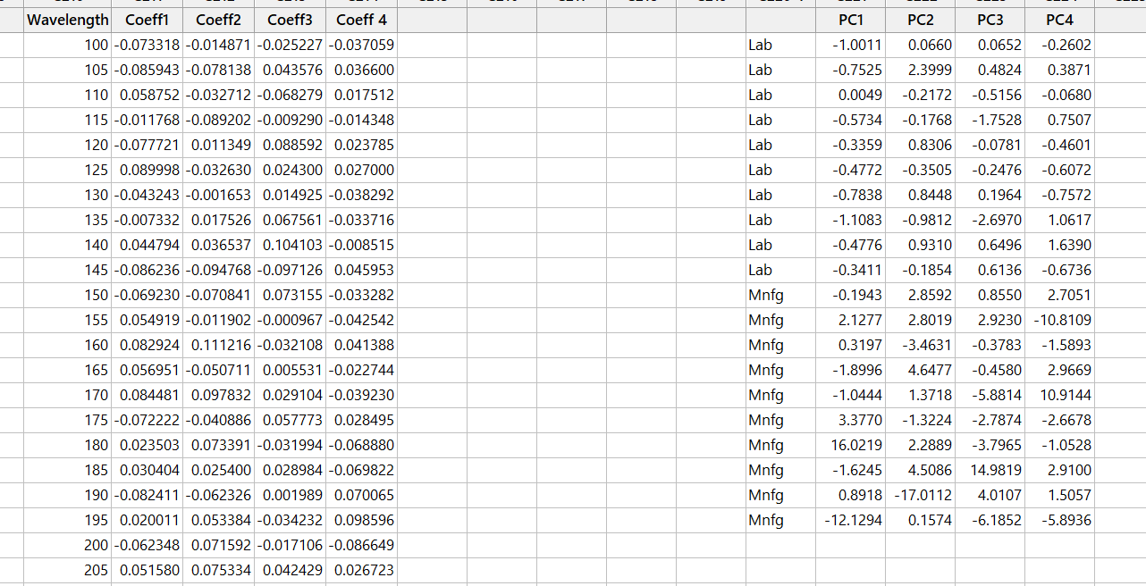
PCA scores

